Slide 1

Week4:
Basis of Deep Learning : rethink deep learning
Machine Learning Using Tensorflow
Shu-Ting Pi, PhD
UC Davis

Slide 2
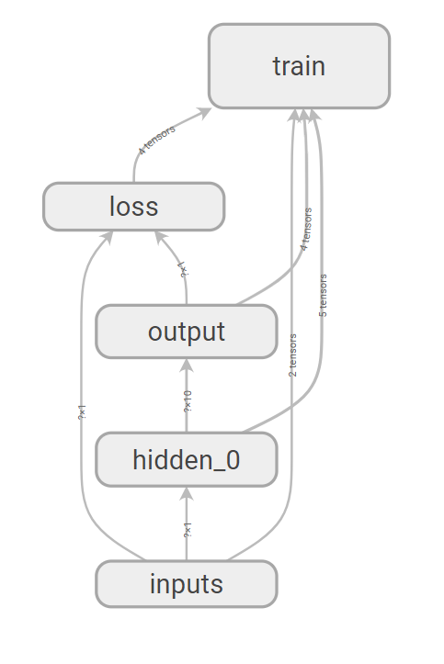


Really understand everything?
bias
1
bias
1
Machine Learning using Tensorflow
Shu-Ting Pi

Slide 3
Questions
Overfitting
  - In general, we can fit “any” data if parameters are many
Dimensionality Curse
  - How many data are consider “enough”?
Gradient vanishing and explosion
  - How deep can a neural network be?
  - Why Relu is better?
Information Theory
  - Ask again: what is deep learning?
Machine Learning using Tensorflow
Shu-Ting Pi

Slide 4
Overfitting

Slide 5
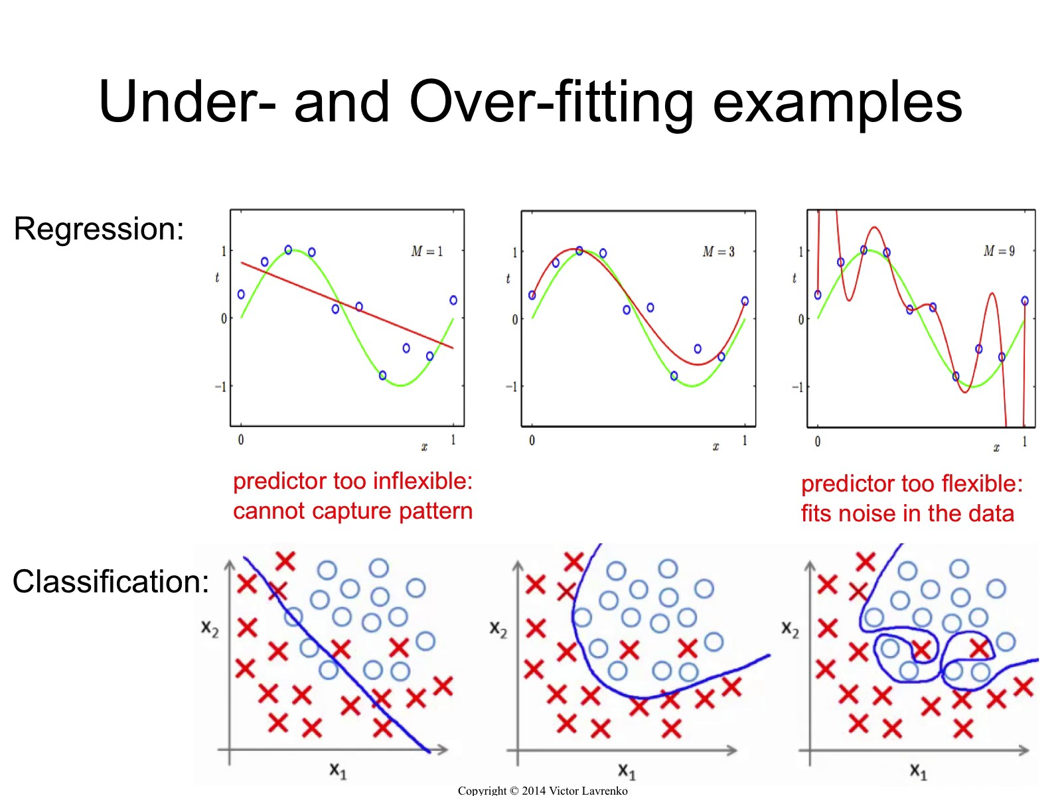
Overfitting
The goal of learning is “generalization” not “accuracy”
Machine Learning using Tensorflow
Shu-Ting Pi

Slide 6
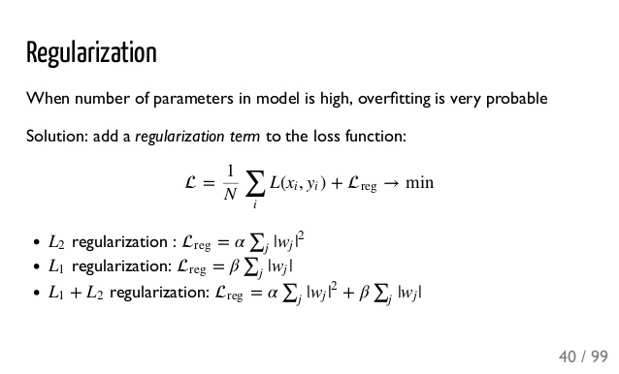
Regularization
Hint: Lagrangian constraints
L1: make more W zero, non-derivative
L2: won't make more W zero, derivative
Machine Learning using Tensorflow
Shu-Ting Pi

Slide 7
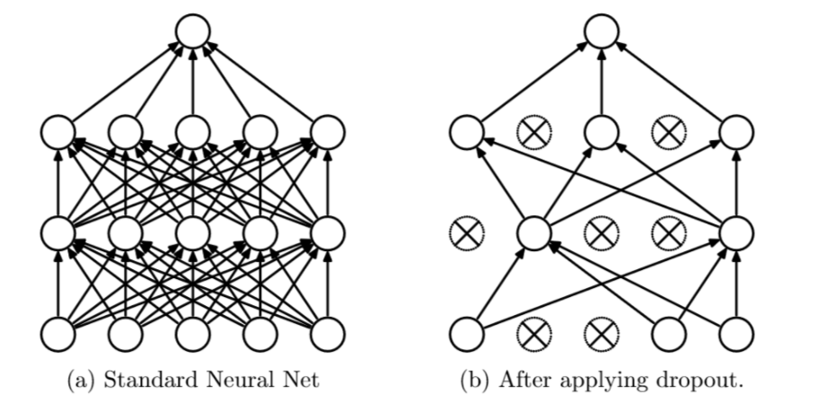
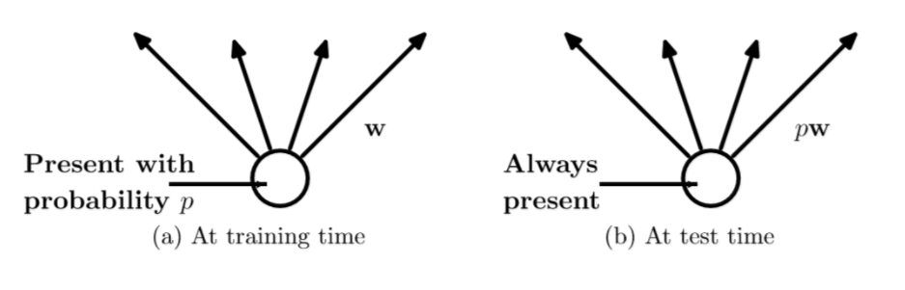
Dropout
Machine Learning using Tensorflow
Shu-Ting Pi

Slide 8
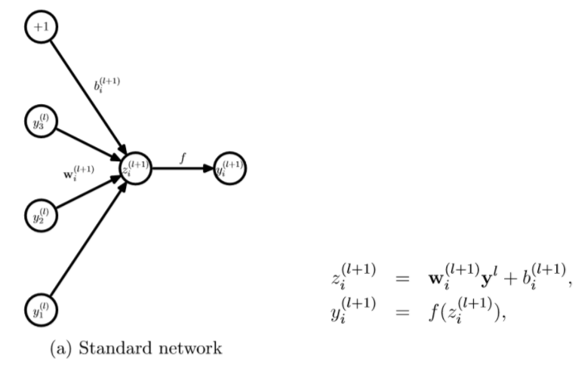
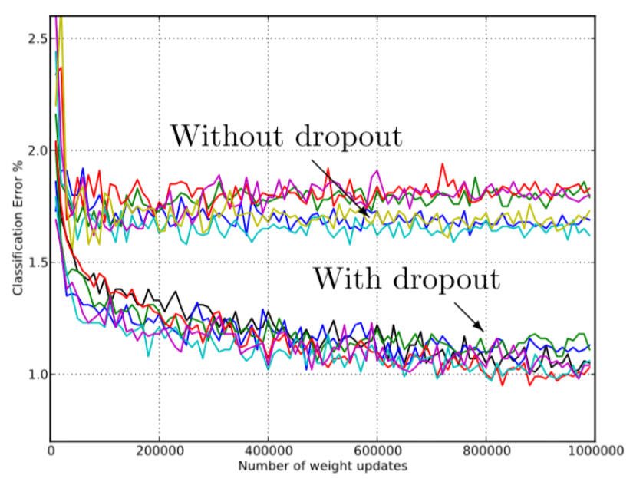
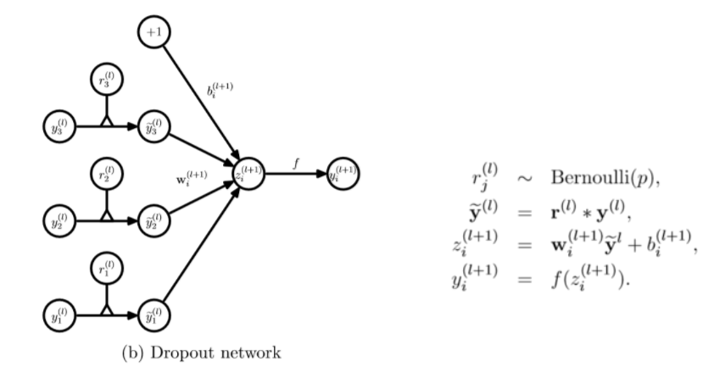
Dropout
Machine Learning using Tensorflow
Shu-Ting Pi

Slide 9
Dimensionality Curse

Slide 10
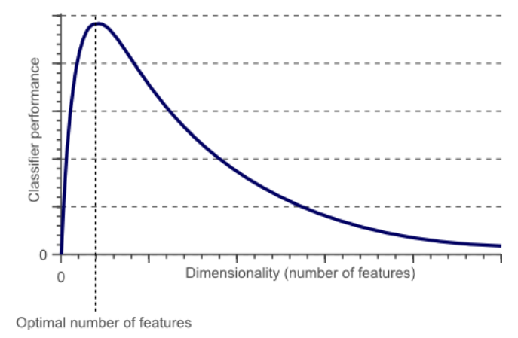
What is dimensionality curse?
Performance decrease beyond a critical number of features
Machine Learning using Tensorflow
Shu-Ting Pi

Slide 11
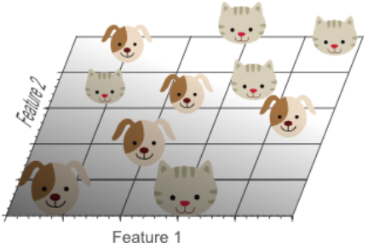
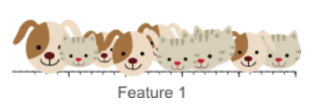
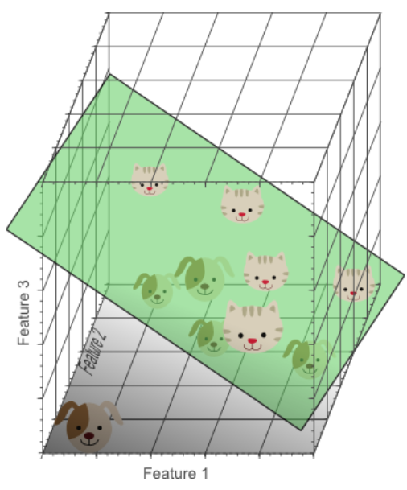
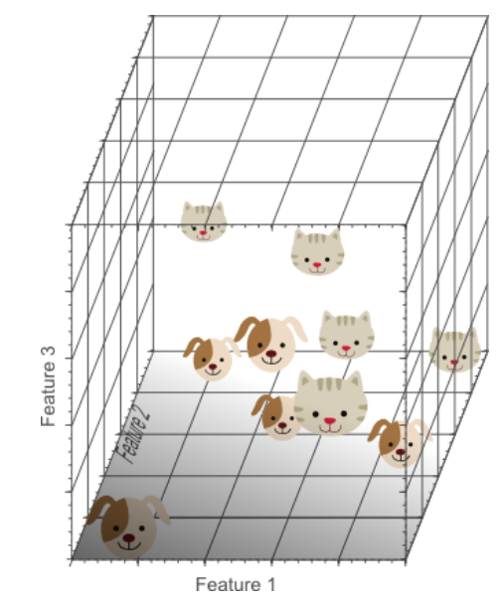
Increase dimension
Machine Learning using Tensorflow
Shu-Ting Pi

Slide 12
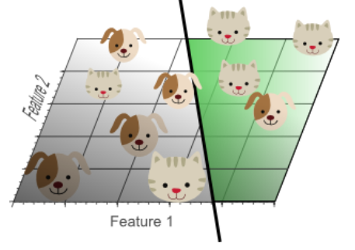
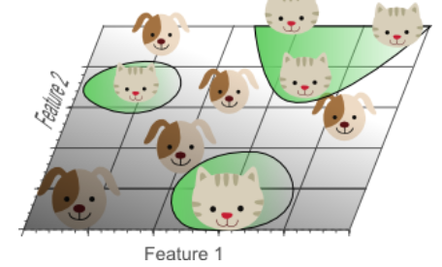
Which one is better?
Project 3D linear separation to 2D
Simple 2D linear separation
Machine Learning using Tensorflow
Shu-Ting Pi

Slide 13
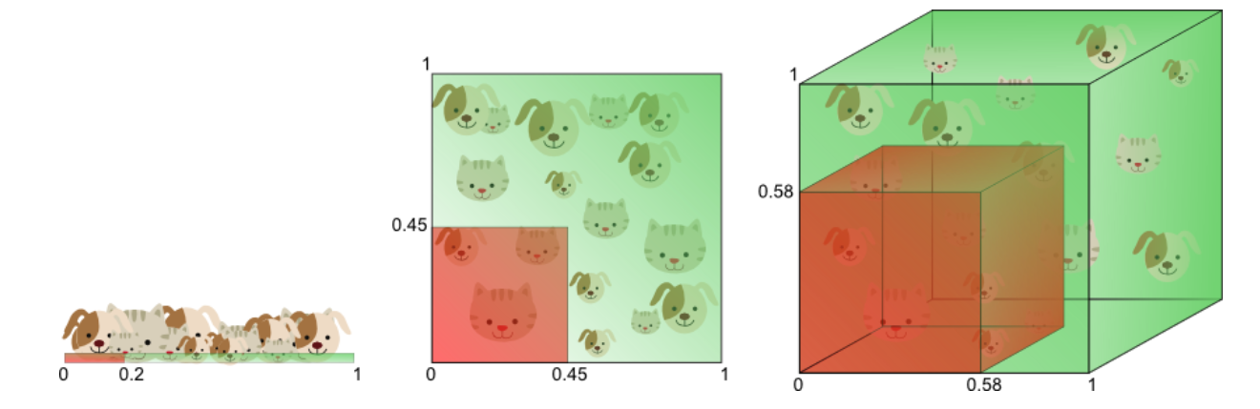
The cubic approach
Want 20% coverage on the value domain:
1D = 0.2 , 2D= 0.45, 3D= 0.58
Machine Learning using Tensorflow
Shu-Ting Pi

Slide 14
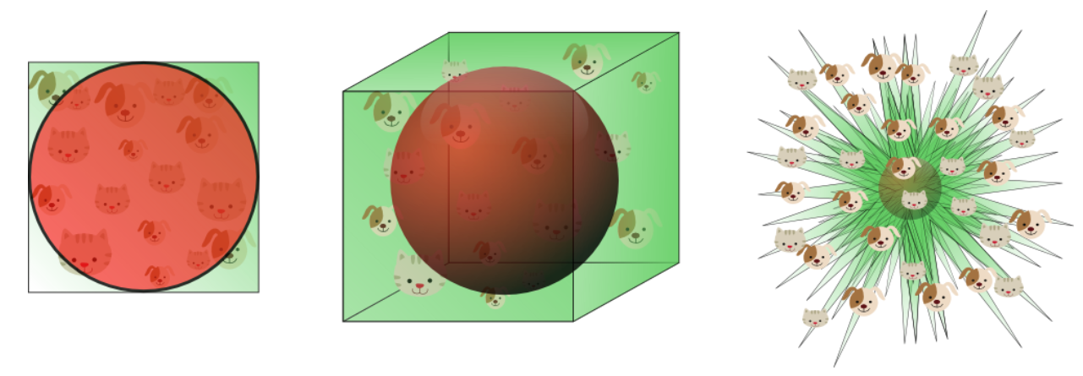
The corner approach
Data around the corner are “sparse” !
98% in the corners !!
Machine Learning using Tensorflow
Shu-Ting Pi

Slide 15
Gradient vanishing & explosion

Slide 16
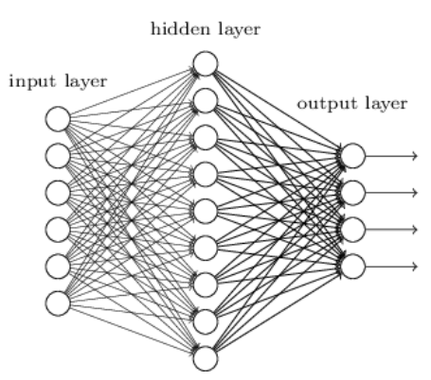
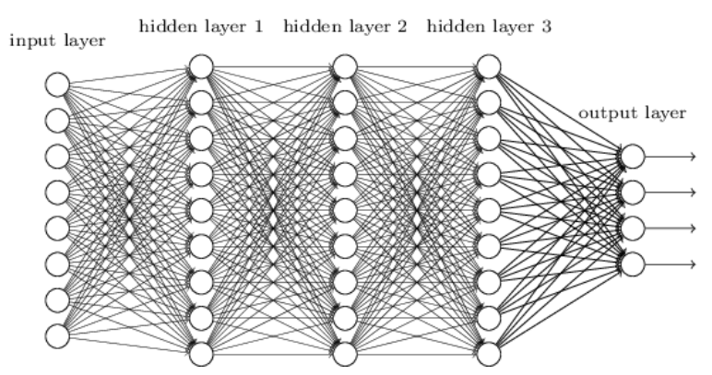
the deeper the better?
Few-layer NN
Many-layer NN
More parameters in many-layer NN, so more features can be extract?
Okay, maybe you are right, but how to train it?
Machine Learning using Tensorflow
Shu-Ting Pi

Slide 17
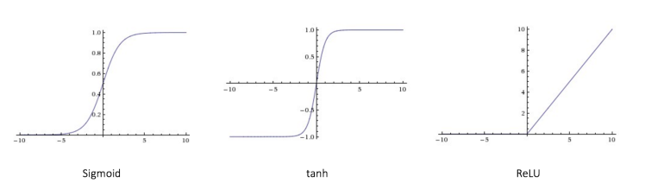
Take a look on activation functions
Machine Learning using Tensorflow
Shu-Ting Pi

Slide 18
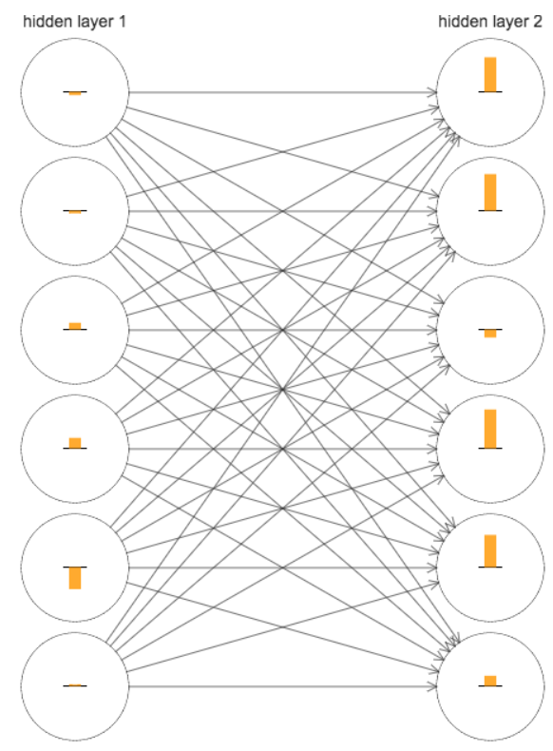
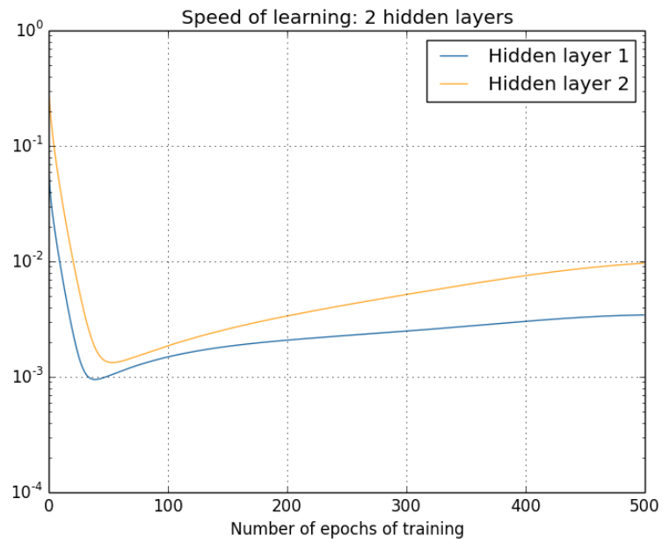
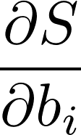
What is Gradient Vanising?
MNIST, sigmoid actvation function
Learning speed:
Machine Learning using Tensorflow
Shu-Ting Pi

Slide 19
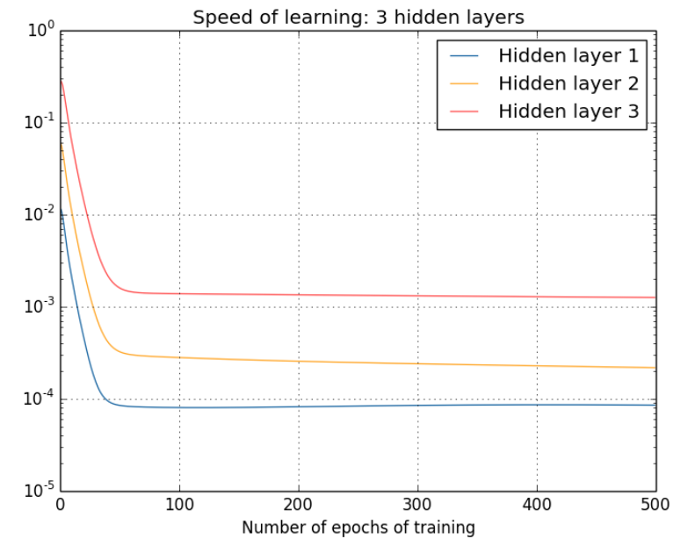
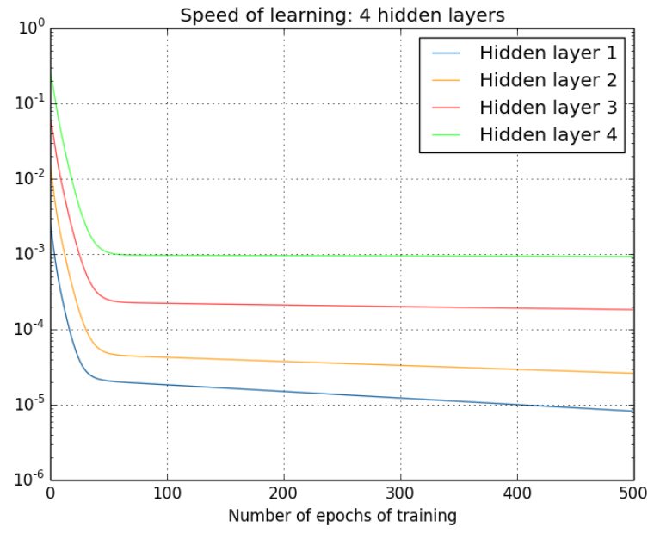
Problem becomes worse in multilayer
Machine Learning using Tensorflow
Shu-Ting Pi

Slide 20
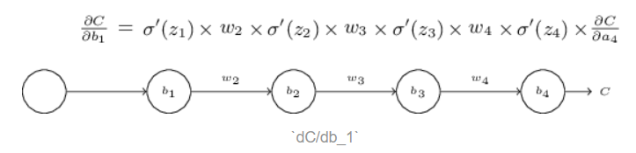
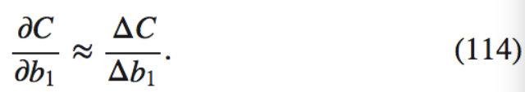

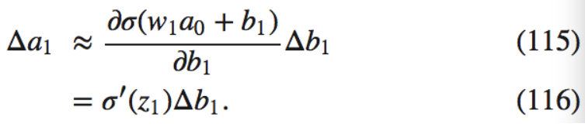
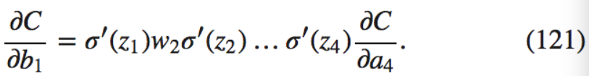
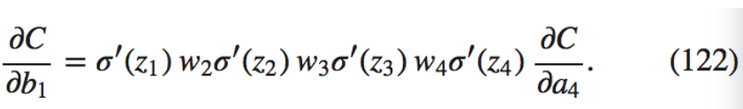
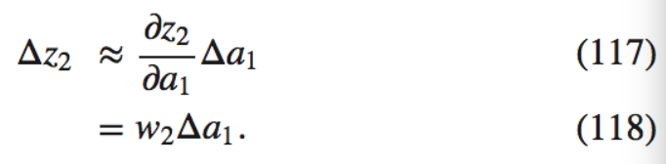
Why gradient vanishing?
Machine Learning using Tensorflow
Shu-Ting Pi

Slide 21
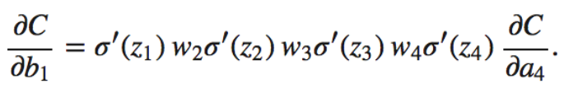
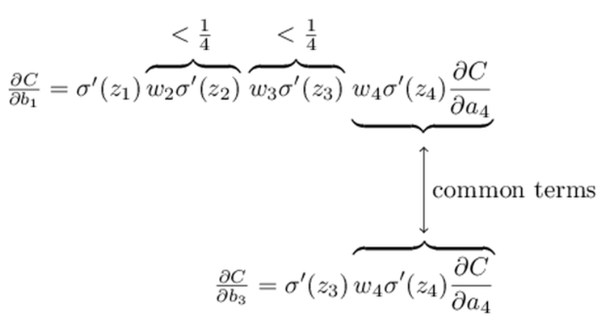
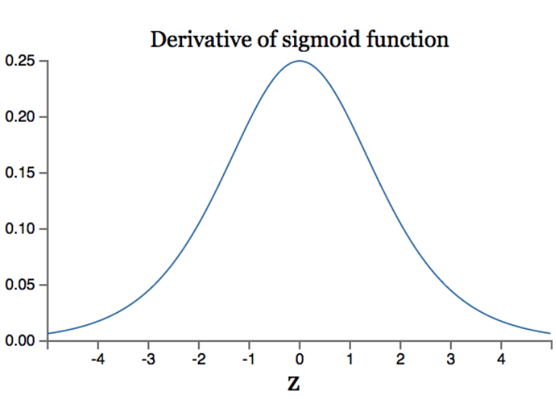
Gradient Vanishing
If all W's<1, all layers contribute a value <1/4, exponential decay. Gradient Vanishing !
If all W's are lager, say, > ¼, exponential increase. Gradient explosion !
Only 25%, at most, errors can propagate backward !
Machine Learning using Tensorflow
Shu-Ting Pi

Slide 22
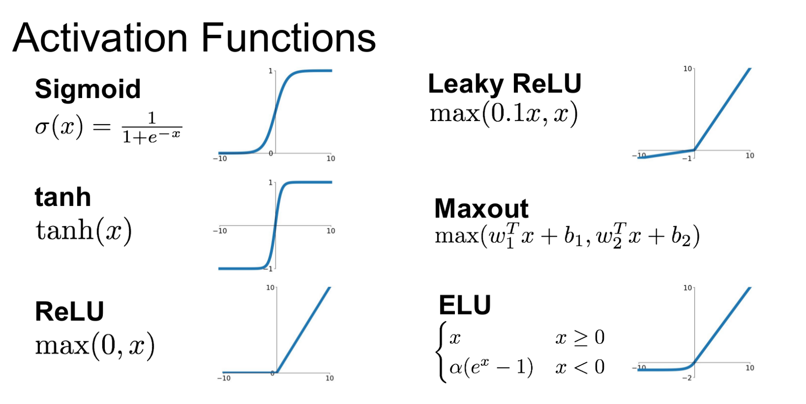
Deep Learning is Gradient Unstable
(Gradient Vanishing)
Better?
Better?
(Gradient Vanishing)
(Node Dying problem)
Better?
Remember: Deep learning neural network is always “gradient unstable”!
Machine Learning using Tensorflow
Shu-Ting Pi

Slide 23
Information Theory

Slide 24
What a neural network really does?
Information
  - Any object or event that can reduce “uncertainty”
Heat
Deep
Learning
Network
Work
X
Y
Entropy
(KL divergene)
Trainer
Deep Learning Network is essential a “Carnot Refrigerator”
Machine Learning using Tensorflow
Shu-Ting Pi

Slide 25
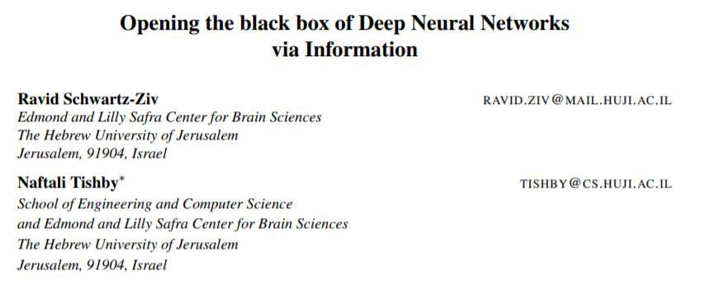

Information bottleneck
Machine Learning using Tensorflow
Shu-Ting Pi

Slide 26
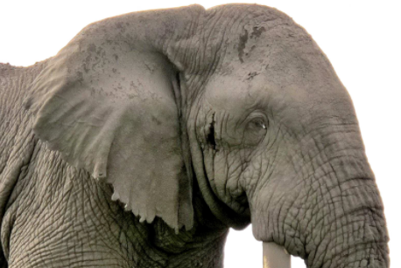
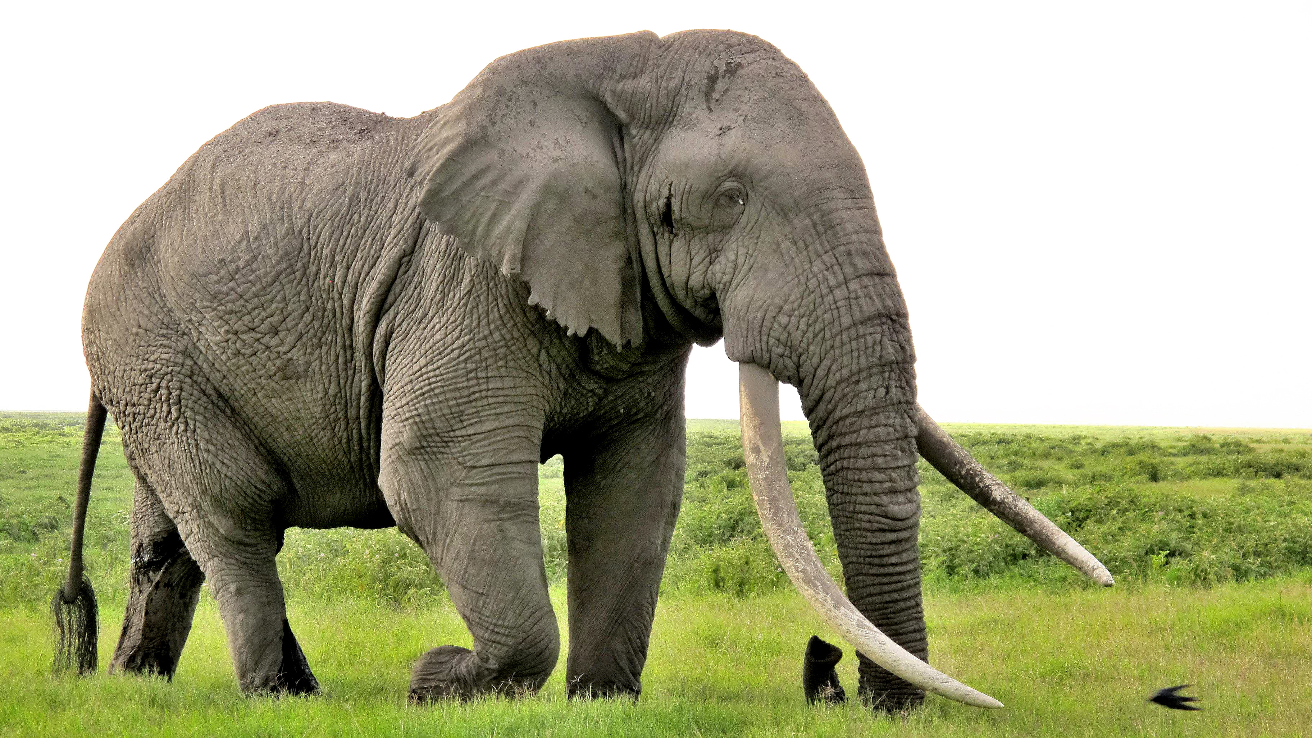
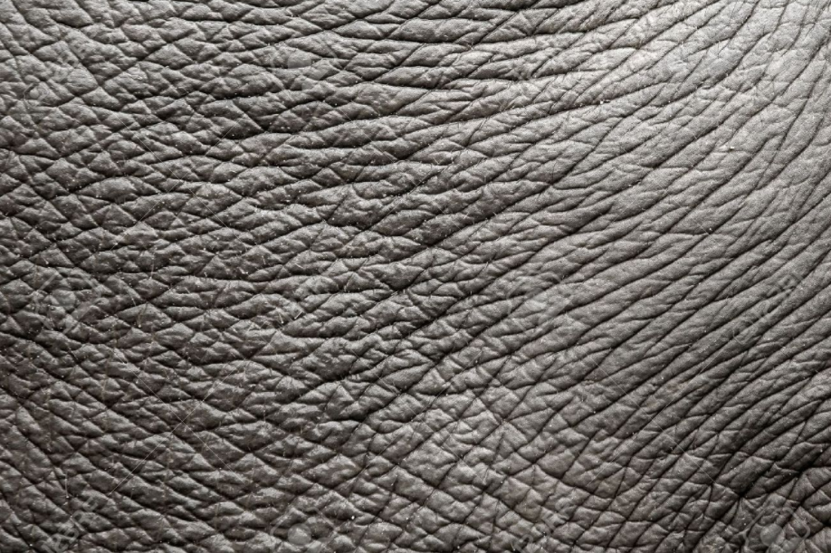
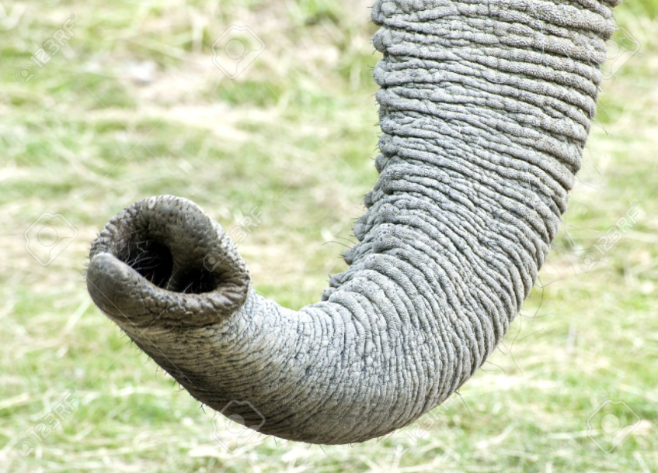
How to reduce uncertainty?
Machine Learning using Tensorflow
Shu-Ting Pi

Slide 27
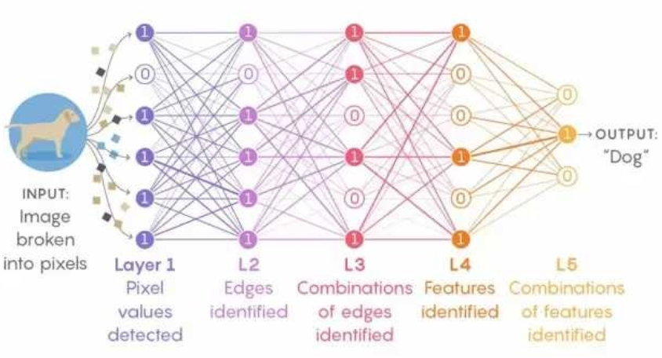
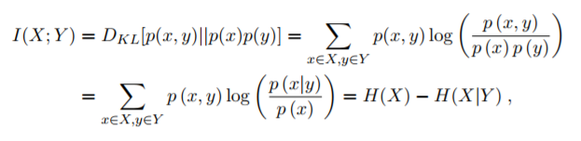
Information Extraction
Matual information:
Machine Learning using Tensorflow
Shu-Ting Pi

Slide 28
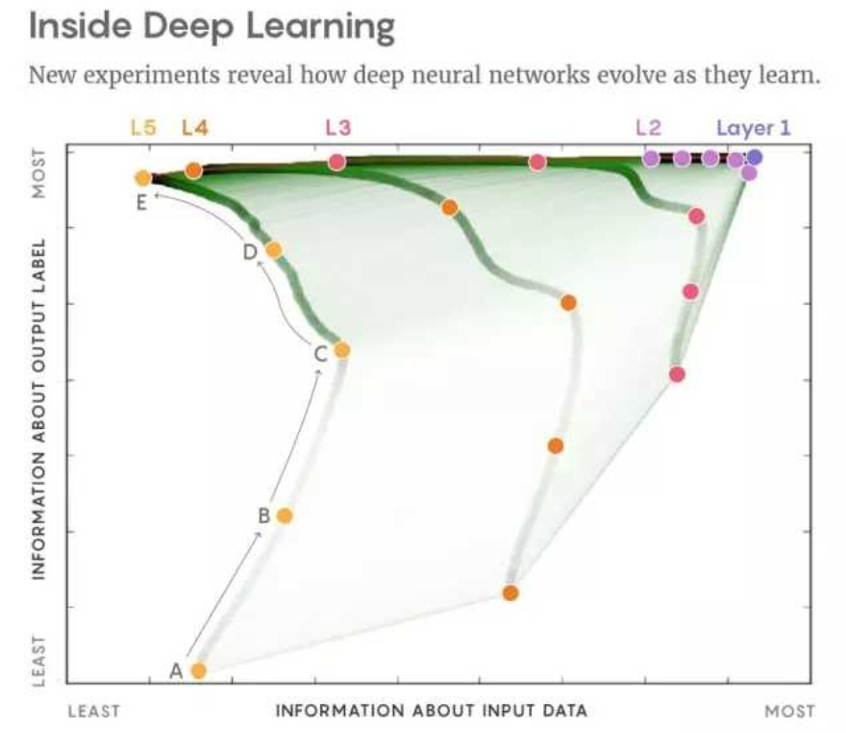
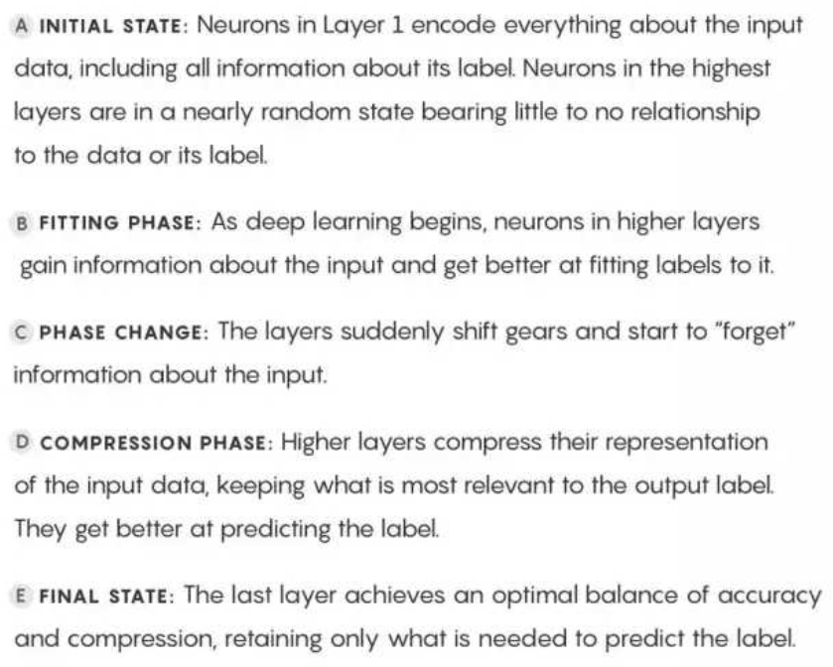
Inside Deep Learning
Machine Learning using Tensorflow
Shu-Ting Pi

Slide 29
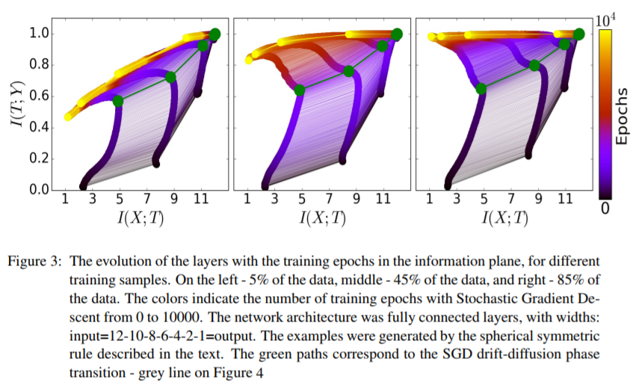
Size of dataset
Machine Learning using Tensorflow
Shu-Ting Pi

Slide 30
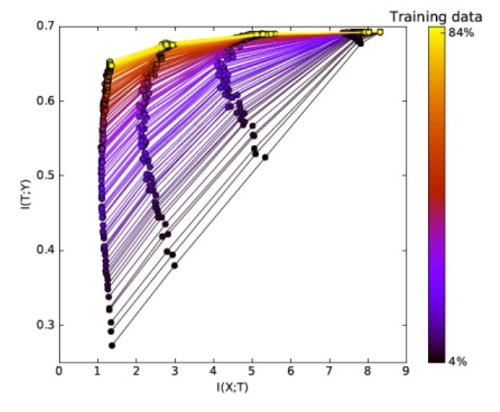
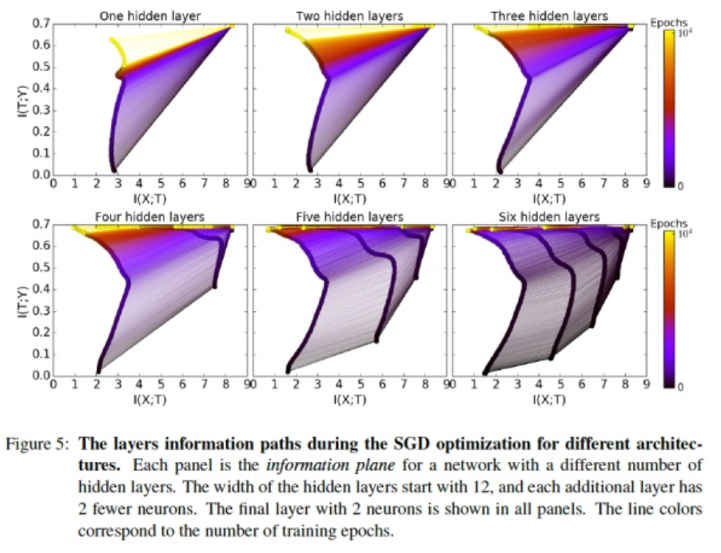
Why multilayer matters?
data size can increase generalization
Multilayer can reduce epochs ! (why?)
Machine Learning using Tensorflow
Shu-Ting Pi

Slide 31
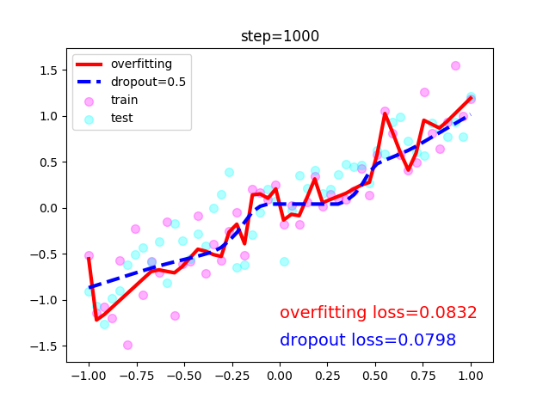
Exercise
Machine Learning using Tensorflow
Shu-Ting Pi

